Slide 1
Beginning Freshmen
Advisement & Enrollment
Academic Success Center

Slide 2
What to Expect During Your Appointment
Brief orientation to some important policies pertaining to you
Advisement regarding your:
Major
General Education
Classes
Enroll!

Slide 3
Course Codes
Prefixes indicate the department
BIOL = Biology
NRSG = Nursing
PSYCH = Psychology
EDUC = Education
KIN = Kinesiology
First number in course code indicates the class level of the course
MATH 0214 = Remedial
ENG 1113 = Freshmen
HIST 2483 = Sophomore
PSYCH 3833 = Junior
ART 4412 = Senior
These are just suggestions as to the type of classwork required to pass the course
Zero-level courses must be completed within 24 credit hours or you are blocked from taking anything else

Slide 4
Course Codes
Last number in course code indicates the amount of credit hours for the course
UNIV 1001 = 1 hour
NRSG 1142 = 2 hours
ENG 1113 = 3 hours
BIOL 1114 = 4 hours
For three credit hour courses…
M W F courses typically meet 50 minutes each day
T R courses typically meet 75 minutes each day
Blended classes (some seat time and some online time)
Online classes (must log in first day of session/many have assignments due the first few days, NOT AT YOUR OWN PACE COURSE)

Slide 5
Course Codes Example Schedule
UNIV 1001 Freshman Seminar
ENG 1113 Freshman Composition I
MATH 0214 Intermediate Algebra
COMM 1113 Fundamentals of Human Communication
KIN 2122 Choices in Wellness
Total hours 13
That is equal to about 39 hours a week of classes, reading, studying, doing homework, meeting with project teams, etc.

Slide 6
Other Schedule Considerations
2
1
Courses may have varying begin/end dates ⁽¹⁾ NOTE: Financial Aid is calculated based on the hours enrolled at the time of last day to drop full semester classes with 100% refund https://www.ecok.edu/current-students/paying-college/financial-aid/financial-aid-modules
Courses may be offered face-to-face, blended, or web ⁽²⁾
Face-to-face courses meet with a live professor at a designated learning site indicated on the schedule. *These courses may still use Blackboard for distribution of course materials and submission of assignments
Blended courses have a combination of face-to-face meetings along with work required
Web classes have no face-to-face requirements; coursework is typically conducted through Blackboard
Web classes will require Respondus Lockdown Browser and video/audio capabilities
Web courses have additional fees
Courses may require specific technology, materials or resources (information provided in the course syllabus and/or the bookstore textbook information)
Courses may have fees not provided in the sample cost of attendance information (see full list of fees from the Office of the Bursar)

Slide 7
Skills Deficiency Remediation
Skills Remediation: Incoming students who have skills deficiencies (18 or lower in English, Math, Reading, or Science on the ACT or SAT equivalence) must remove these deficiencies in the first 24 hours they attempt at ECU. This may be accomplished in any of the following ways:
Accuplacer Testing scheduled with the Academic Success Center and make the cut score or higher for each area in which a deficiency exists
Take the ACT National after sixty (60) days following the last ACT National taken
Take the ACT Residual offered at ECU and accepted only for ECU students
Take and pass the required zero-level course(s) for any area in which a deficiency exists
Take and pass the co-requisite courses for English 1113 and Math 1513 or departmental exams in English and Science (not applicable to Curricular Deficiencies)
See the ECU CATALOG Remediation Policy Basic Academic Skills section for details https://www.ecok.edu/academics/catalog

Slide 8
Removing Deficiencies through Testing
ACCUPLACER Testing conducted by the ECU Academic Success Center
The ACCUPLACER test may be taken two times
First attempt is FREE
Second attempt must be 30 days or more after the initial test at a cost of $15
May NOT be taken if the student is enrolled in the developmental course, and the course has already met.
Schedule ACCUPLACER Tests with the Academic Success Center 580-559-5696; asc@ecok.edu
Sample questions and information about the test may be found online https://accuplacer.collegeboard.org/students (Next Generation writing; reading comprehension; and/or quantitative reasoning, algebra, and statistics).
Take the ACT National after sixty (60) days following the last ACT National taken
Take the ACT Residual conducted by ECU Testing and Accessibility Services
Offered at ECU and accepted only for ECU students
May be taken only once in a calendar year
Schedule ACT Residual Test with Testing and Accessibility Services 580-559-5677; tasstu@ecok.edu
https://www.ecok.edu/current-students/student-services/office-testing-and-accessibility-services

Slide 9
Removing Deficiencies through Coursework
Take and pass the required zero-level course(s) for any area in which a deficiency exists
Math ACT below 16: MATH 0214 Intermediate Algebra
Reading ACT 18 or lower: EDUC 0111 Developmental Reading
Science Act 18 or lower: PHSCI 0123 Concepts in Science
Take and pass the co-requisite courses for English 1113 and Math 1513 or departmental exams in English and Science (not applicable to Curricular Deficiencies)
English ENG 0211 English Writing Lab & ENG 1113 Freshman Composition I
MATH (ACT of16 or higher)
For majors requiring Survey of Mathematics MATH 1413 & MATH 0411
All other majors require one of the following:
MATH 0512 & MATH 1513
MATH 0612 & MATH 1613
MATH 0221 & MATH 1223
Specific sections must be taken together

Slide 10
Advice for the First Semester
Schedule courses to your interests/strengths
If you are not a morning person, don’t schedule College Algebra for 8:00 a.m.
If you are not a strong student in a particular area, don’t schedule another difficult class directly before or after that course
If you are not great at Math, don’t schedule a Math course right before General Zoology
Don’t put all your courses on the same day (if permissible) to avoid brain/work overload
Some point in the semester you will have: a test in one class, paper due in another, presentation in a third, and quiz in the last class all on the same day if you do
If you are sick one day, you end up missing ALL of your class lectures; if you split your schedule you would only miss a few
Give yourself a break!
Scheduling a class at 8:00, 9:00, 10:00, 11:00, 12:00, 1:00, and 2:00 sounds like you are getting a lot done quickly, but you will find yourself dragging and feeling drained even quicker without some sort of a break between classes
Don’t forget lunch! Remember, food = brain fuel

Slide 11
15 to Finish
Watch this video for tips to plan your college experience to graduate on time. https://www.youtube.com/watch?v=hWFMfjTGgDU
Return to this presentation when you are finished.

Slide 12
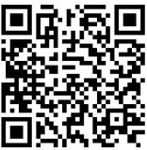
Important Offices
Academic Success Center 580-559-5696 ADMN 262
Admissions 580-559-5233 ADMN 102
Bursar 580-559-5955 ADMN 108
Computer Help Desk 580-559-5884 DANLEY 102
Counselor & Health Services 580-559-5713 STU. UNION 137
Financial Aid 580-559-5243 ADMN 101
Housing 580-559-5602 ADMN 155
Information Desk 580-559-5741 UNIV. CENTER
Library 580-559-5376
Records 580-559-5236 ADMN 111

Slide 13
Estimate of Cost-For 2019-2020¹ How Much?
Resident (In-State) 15 Credit Hours
TUITION & FEES*: $3,835
²ROOM &BOARD: $3,536
BOOKS: $ 800 (estimated)
TOTAL: $8,171 per semester
*Course fees will vary based on the individual class or program;
online courses have additional fees
Non-Resident³ (Out-of-State) 15 Credit Hours
TUITION & FEES*: $8,515
²ROOM& BOARD: $3,536
BOOKS: $ 800 (estimated)
TOTAL: $11,080 per semester
*Course fees will vary based on the individual class or program;
online courses have additional fees
Prices for 2020-2021 have not been approved. Updates will be
ROOM&BOARD INCLUDES DOUBLE OCCUPANCY ROOM AND BASIC 10 MEAL PLAN; PRICES ARE SUBJECT TO CHANGE
Non-Resident Waivers may be applied automatically or requested if requirements are met.
See PAYING FOR COLLEGE, FINANCIAL AID and OFFICE OF BURSAR pages for more information

Slide 14
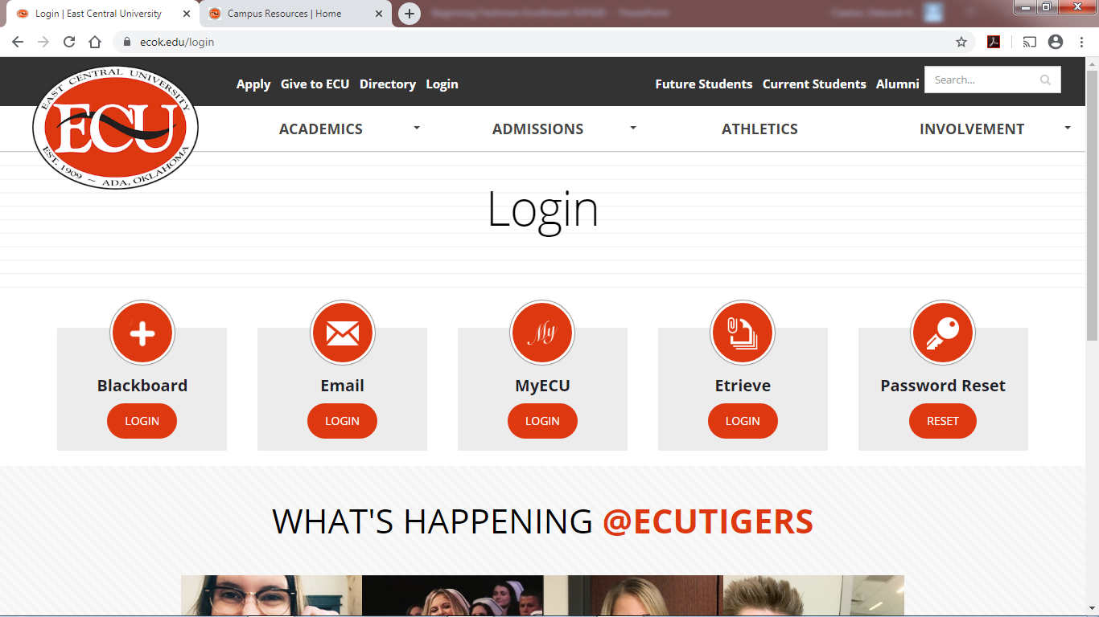
Login Resources

Slide 15
Login Resources
PASSWORD RESET—Obtain your ECU login and password here. You will be asked for:
SSN
Date of Birth
EMAIL—Check your ECU email daily. This login requires the full email address (username@email.ecok.edu)

Slide 16
Login Resources cont’d
MyECU— Campus communications and all of your ECU business; requires only the username for login (see next slides)
ETRIEVE—Campus forms (Major change, course substitution, waivers and extensions, etc.); requires full email address
Blackboard—Online course delivery

Slide 17
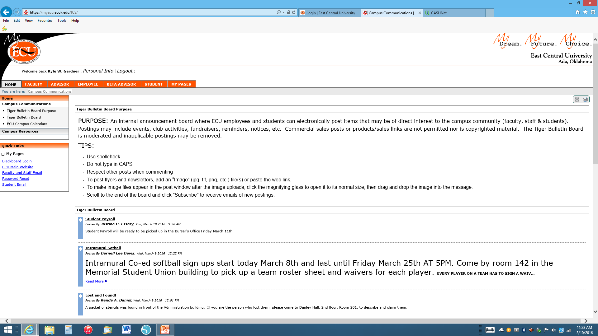
Using MyECU
What’s Happening On Campus?

Slide 18
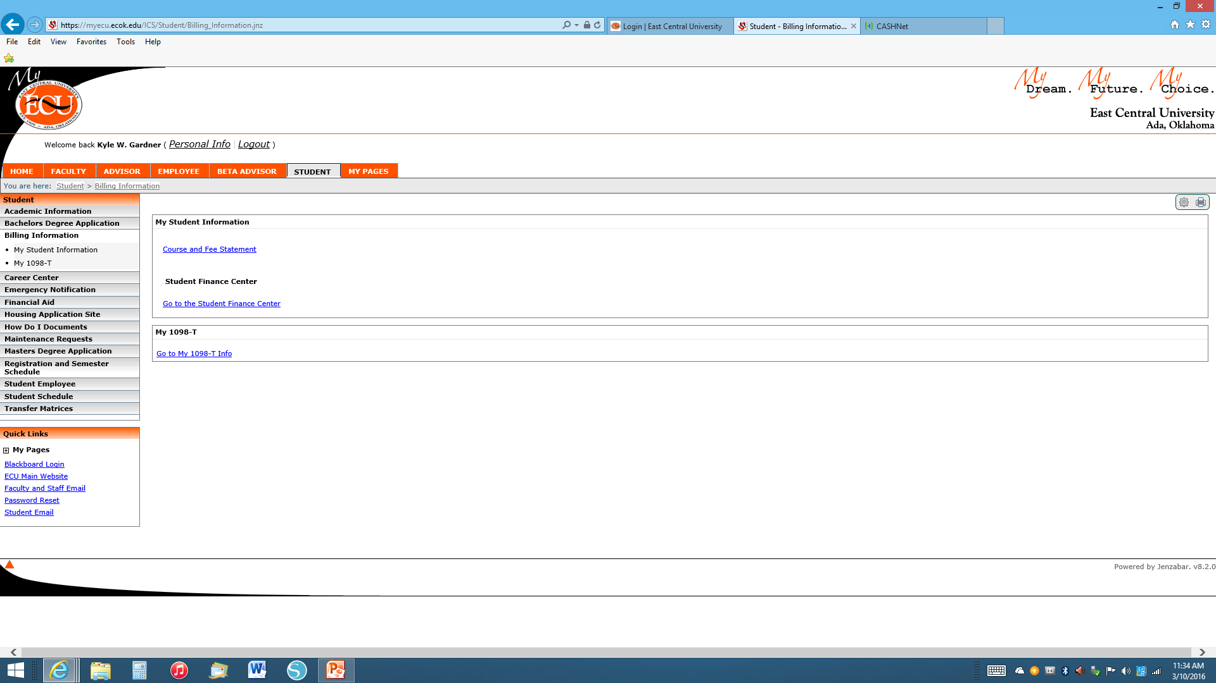
Using MyECU Continued
How Do I Pay My Balances?
Check your semester fees
Manage your account

Slide 19
Checking Your Account
Viewing Account
Make Payments – eCheck is FREE!
Parent PIN (OPTIONAL)

Slide 20
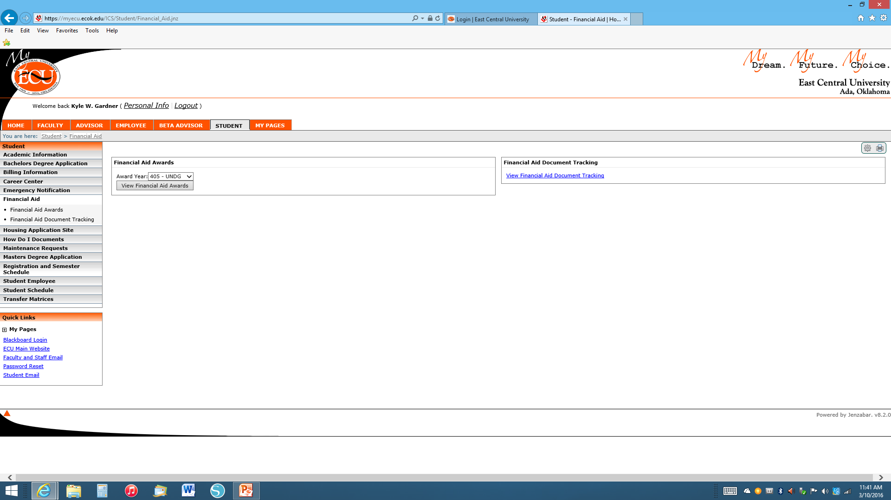
Using MyECU Continued
What About My Financial Aid?
View your awards
Track your documents

Slide 21
BankMobile Tiger Card
When you enroll you will be sent a GREEN envelope from Bank Mobile that is a refund selection kit (no card). It will give you directions to login and select your refund option, either Tiger Card or your personal bank account. If you select the Tiger Card then a card is mailed to you.
The refund card is designed to provide you with a faster way to receive your financial aid or school refunds. Easy Refund is by far the fastest and easiest way to gain access to your refund money - literally the same day ECU processes it.
Students MUST activate their card at least 3 business days prior to the refund day. Financial aid refunds disbursed through the BankMobile Easy Refund will be applied either directly to the card or to your personal checking account (whichever you choose).
Remember, even if you are not currently expecting a refund from ECU, we may have a refund for you in the future.
For additional information please email bridham@ecok.edu.

Slide 22
Final Notes
If you have a disability and require special services, please visit Testing and Accessibility Services in Fentem Hall Room 302.
Tell your advisor today if:
You have or are planning to complete any AP Exams
You have completed any concurrent courses
You are going to be a student-athlete
You have a job and need to schedule around work hours
You have other needs/duties that require your time
Family duties
Commuting long distance
See the Academic Calendar for important date and deadlines

Slide 23
Next steps
Apply for Housing https://www.ecok.edu/housing
Submit required immunizations
Requirements https://www.ecok.edu/sites/default/files/website_files/Current_Students/Student_Services/Health_services/Immunization_Requirements-052019.pdf
Health Services Information https://www.ecok.edu/current-students/student-services/student-health-services
Submit additional/updated academic records
Final high school transcript with grades and graduation date
Official transcript/s from institutions where you completed concurrent coursework
AP/CLEP scores
Follow up with Financial Aid https://www.ecok.edu/current-students/paying-college/financial-aid

Slide 24
Next steps cont’d
Obtain required course materials http://www.ecubookstore.com/home
Secure a Student ID & Parking Pass from the Information Desk at the University Center
Find your classrooms and become familiar with the camps https://www.ecok.edu/about-east-central-university/campus-map

