Slide 1

Tiger Set Up Orientation
A Guide to Ease Your Transition

Slide 2
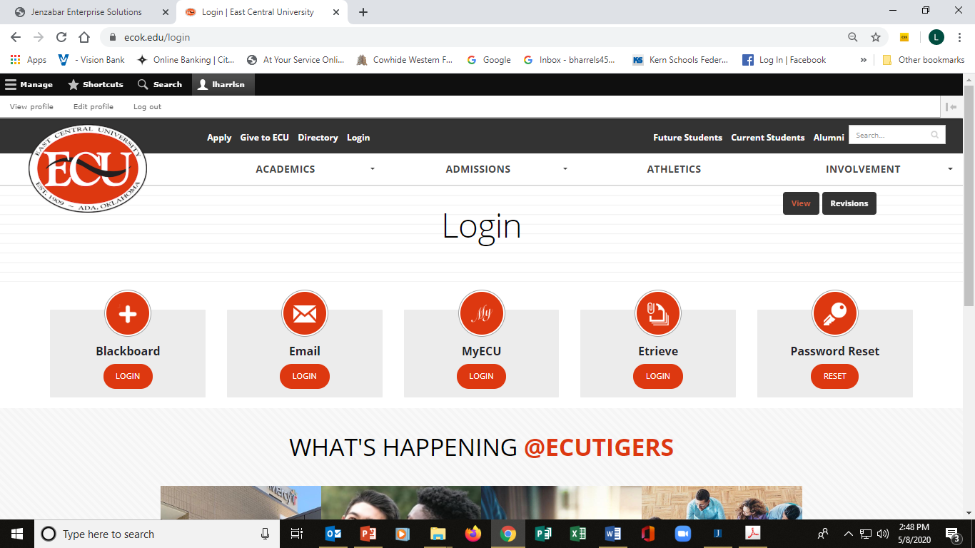
Obtaining Username & Password
www.ecok.edu/login
  Go to: Password Reset
    Enter birthdate & SSN
    Passwords are CASE SENSATIVE
    Write down on something you will not lose
    Take a picture with your phone
    Do NOT share with anyone

Slide 3
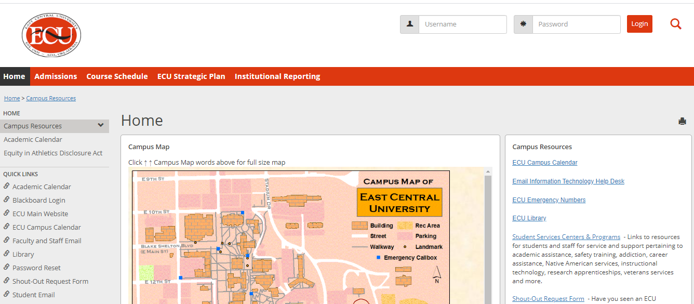
Log on to MyECU
Click on the MyECU link
Enter Username and Password

Slide 4
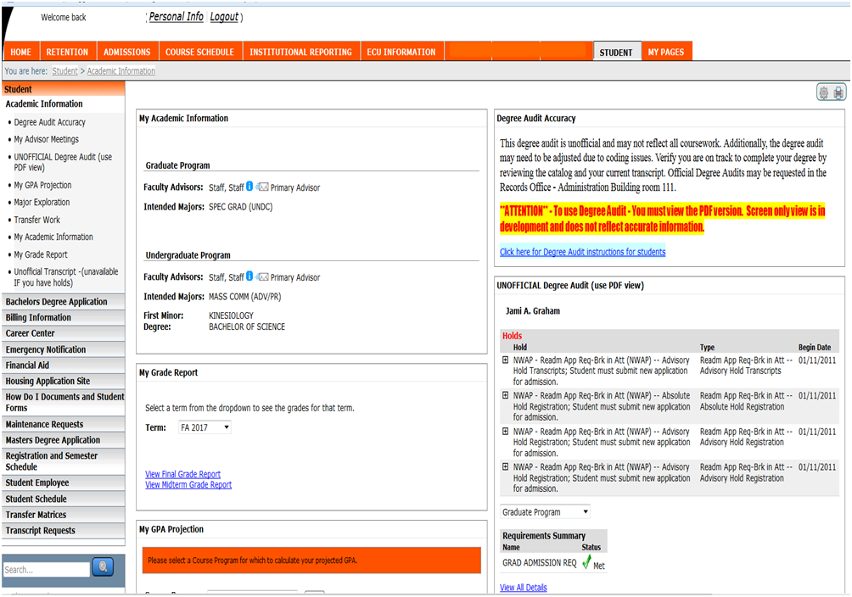
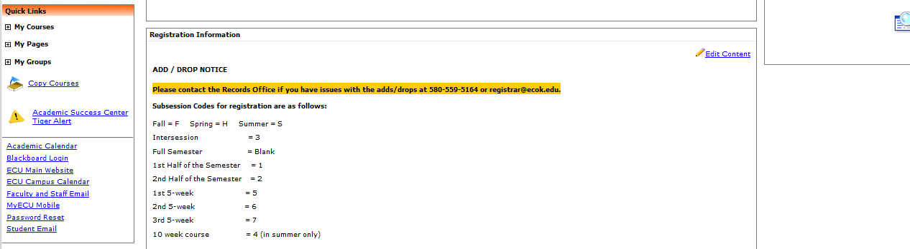
MyECU
My Home Tab
Horizontal tabs
Home
Admissions
Course Schedule
Institutional
Reporting
ECU Information
Student
MyPages
Left Hand Tab
Academic and personal Information
  Quick Links

Slide 5
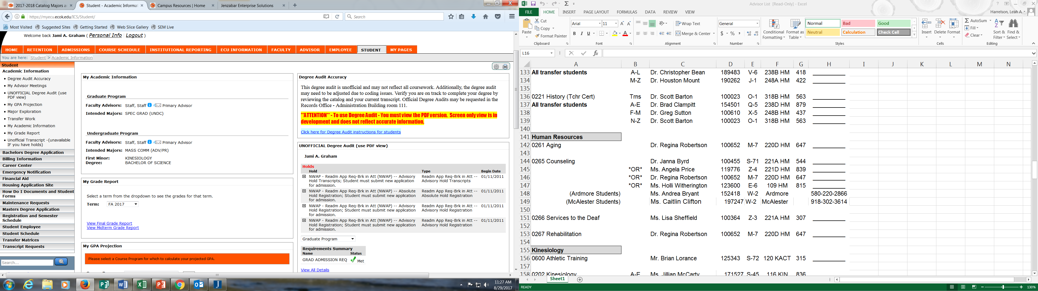
MyECU: Student Tab
Important Left had tabs:
Bachelors Degree Application
Billing Info
Financial Aid
Registration and Semester Schedule
Student Schedule
And More!
Other important things you find on the Student Tab
*Major and Advisor *Grades- Midterm and Final * Unofficial Degree Audit *Holds

Slide 6
MyECU: Student Tab Unofficial Transcript
    Can be printed
    Will show all courses completed each semester
    Will not appear immediately for transfers
    Must have ALL official transcripts submitted to ECU to be recorded

Slide 7
MyECU: Student Tab Transfer Work
    Shows how courses are equated at ECU
    Top line is ECU equivalent
    Bottom line is original course completed
    If no ECU equivalent is shown, you may need to meet with your advisor for a substitution request for a required course

Slide 8
Transfer Work: Course Substitutions
If you have completed a course that is not showing to be the equivalent of an ECU course
  Meet with advisor and review Transfer Work
  Complete Course Substitution Request Form
  ( Located in the Etrieve button on the login page)
  Course description from college/university catalog can help
  Syllabus from course works best

Slide 9
ETrieve
All Forms are electronic in the ETrieve button

Slide 10
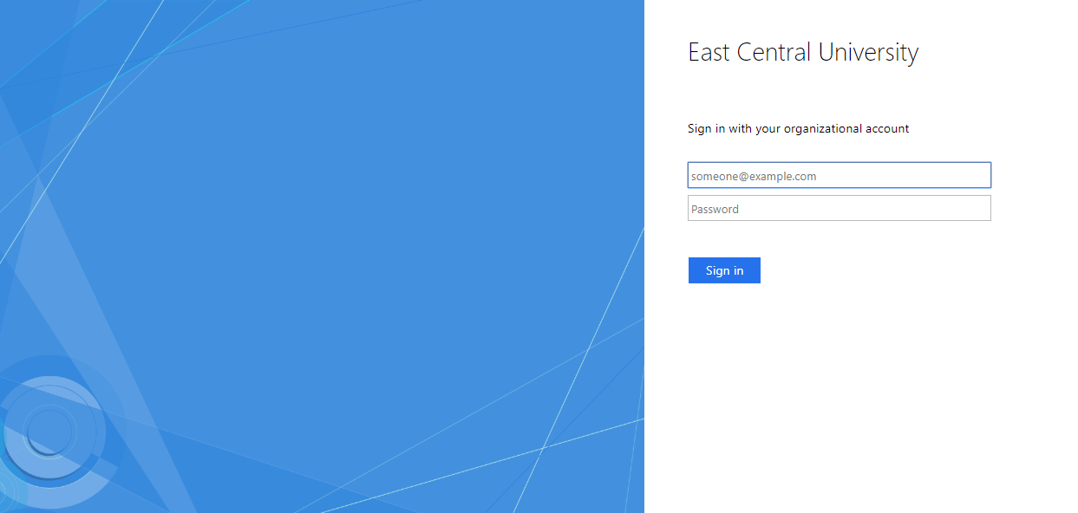
ETrieve
Sign in with your ECU Student Email and Password

Slide 11
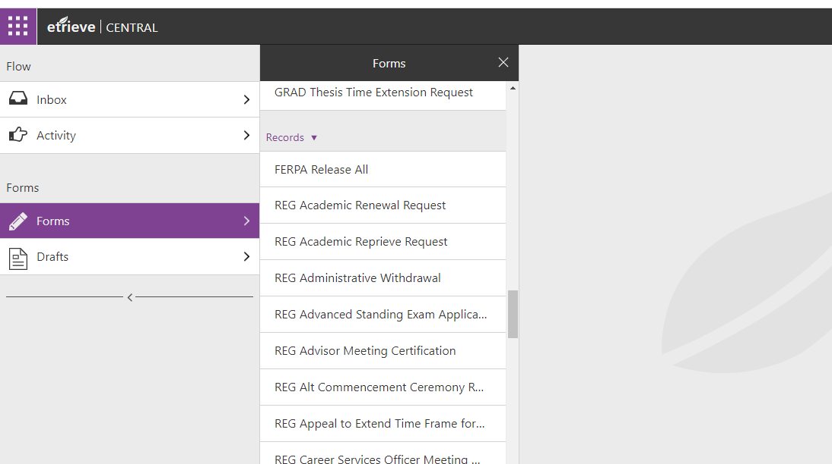
ETrieve
All Records Office Forms can be found that you might need
Course Substitution
Change of Name
Degree Change
FERPA Release
Request for Degree Audit
And more!

Slide 12

Blackboard
Login with your username
and
password
    Download the Blackboard App
    https://itunes.apple.com/us/app/blackboard-app/id950424861?mt=8

Slide 13
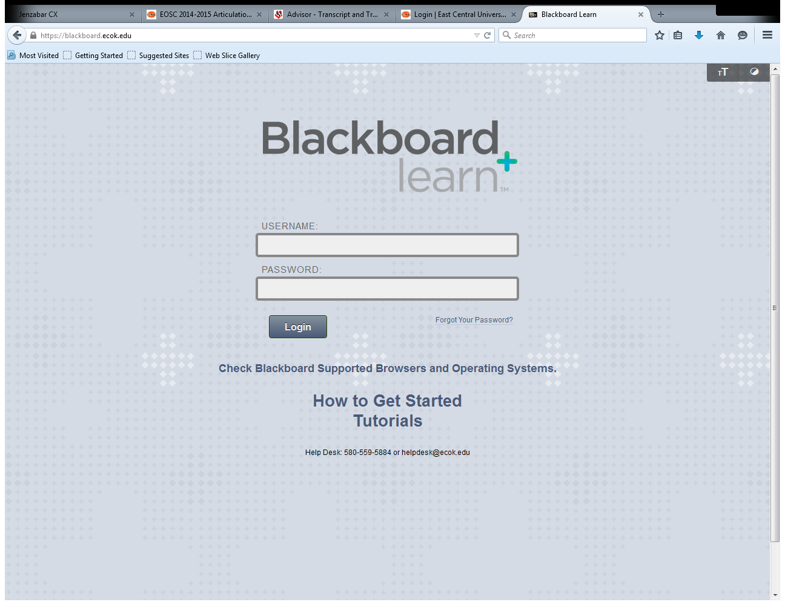
Blackboard Tutorials
www.ecok.edu/login
    How to Get Started Tutorials
    Used for online, blended, and enhanced courses
    Not all courses have a Blackboard component
    Cannot access until the week before classes start up to the 1st day of class if you are a new student to ECU

Slide 14
Blackboard Cont’d
Each professor can set up the class differently
  Exams can be titled “Tests” or “Assessments” or
  “Modules”
  Email vs. Messages
  Email refers to syncing with your ECU Student Email
  Messages stay within the course and does not go to emails

Slide 15
Student Email
  Your ECU e-mail is the “Official” correspondence for you with ECU faculty/staff
    ECU faculty/staff will not reply to emails from personal email addresses from yahoo, gmail, hotmail, etc.
    Can be forwarded to personal email.
      Replying from other account will NOT be sent from ECU account and will go into the spam of the receiver.
      Log in to the Student email

Slide 16
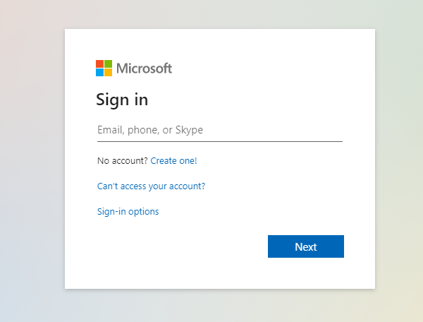
Student Email
Enter
(your username@email.ecok.edu)

Slide 17
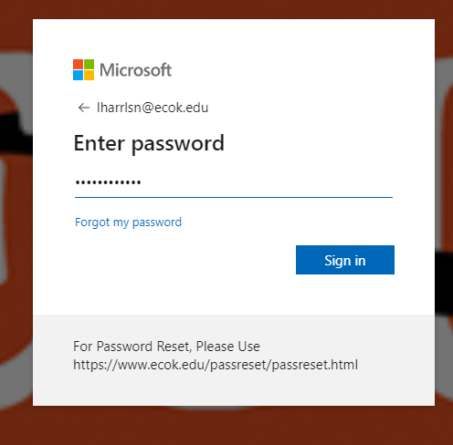
Student Email
Same Password as your MyECU

Slide 18
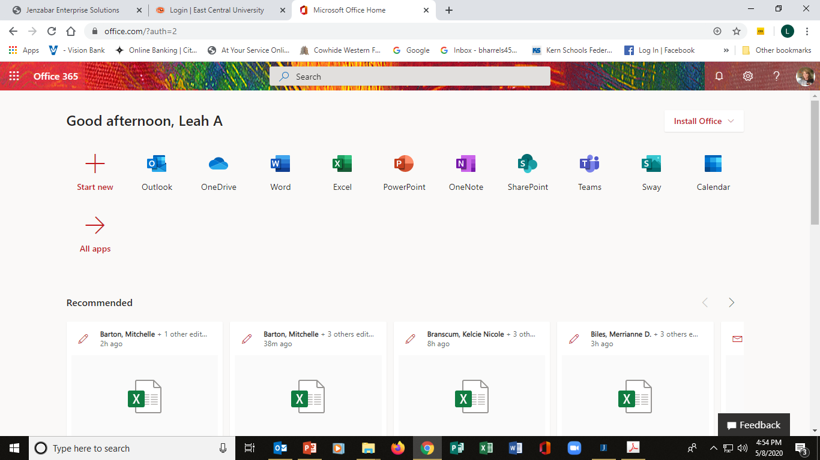
Student Email
You will be logged into OFFICE 365. Outlook is your Student Email Provider

Slide 19
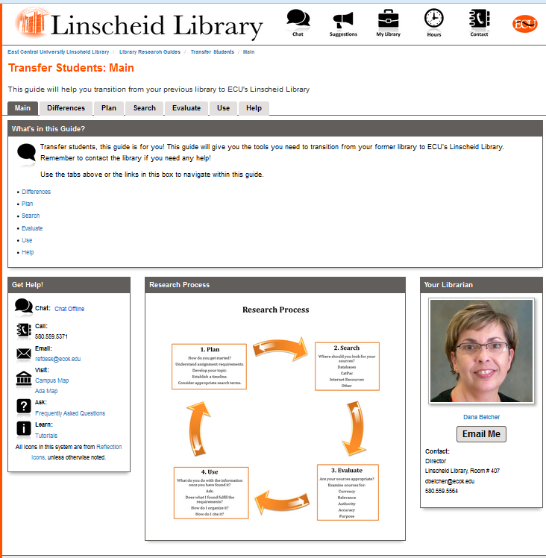
Linscheid Library Tutorials
  Go to: http://ecok.libguides.com/transfer_students
  Transfer pages helps with transition from previous library
  Research guides available
  Librarian contacts

Slide 20
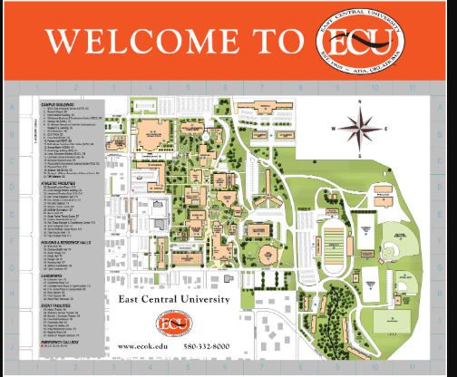
Campus Map Key
Finding your class’s building
  Use your schedule
    HOMN = Horace Mann
    FAUS = Faust Hall
    SCHL = Science Hall
    PES = Physical & Environmental Science
    FFAC = Hallie Brown Ford Fine Arts Center
    CBCC = Chickasaw Business & Conference Center
    ADMN = Administration
    KIN = Kinesiology
    KACT = Kerr Activity Center
    MCBR = McBride Gymnasium
    EDUC = Education

Slide 21
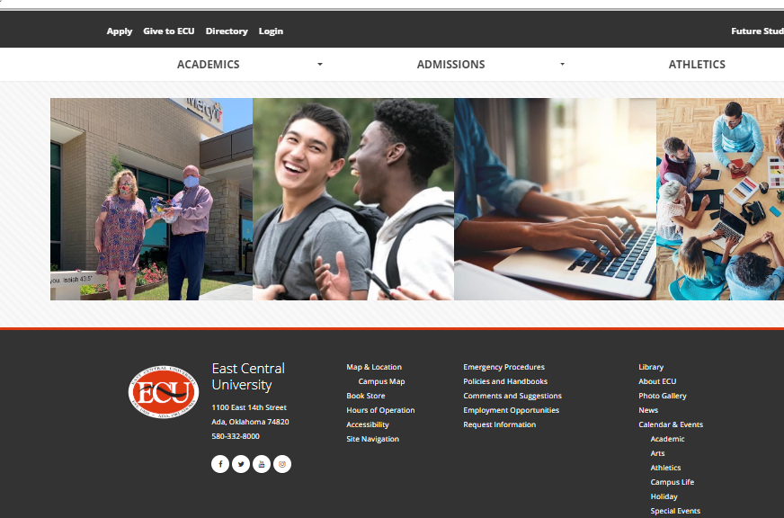
Where do I Find My Books
CLICK HERE

Slide 22
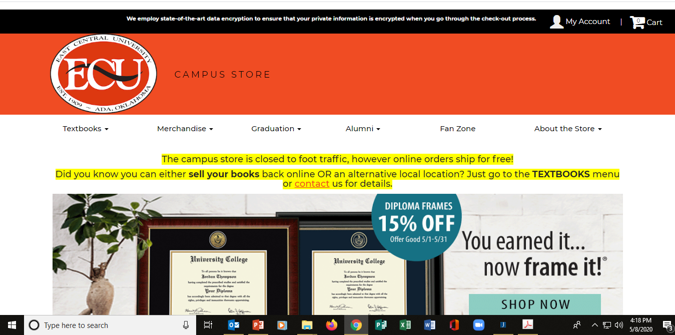
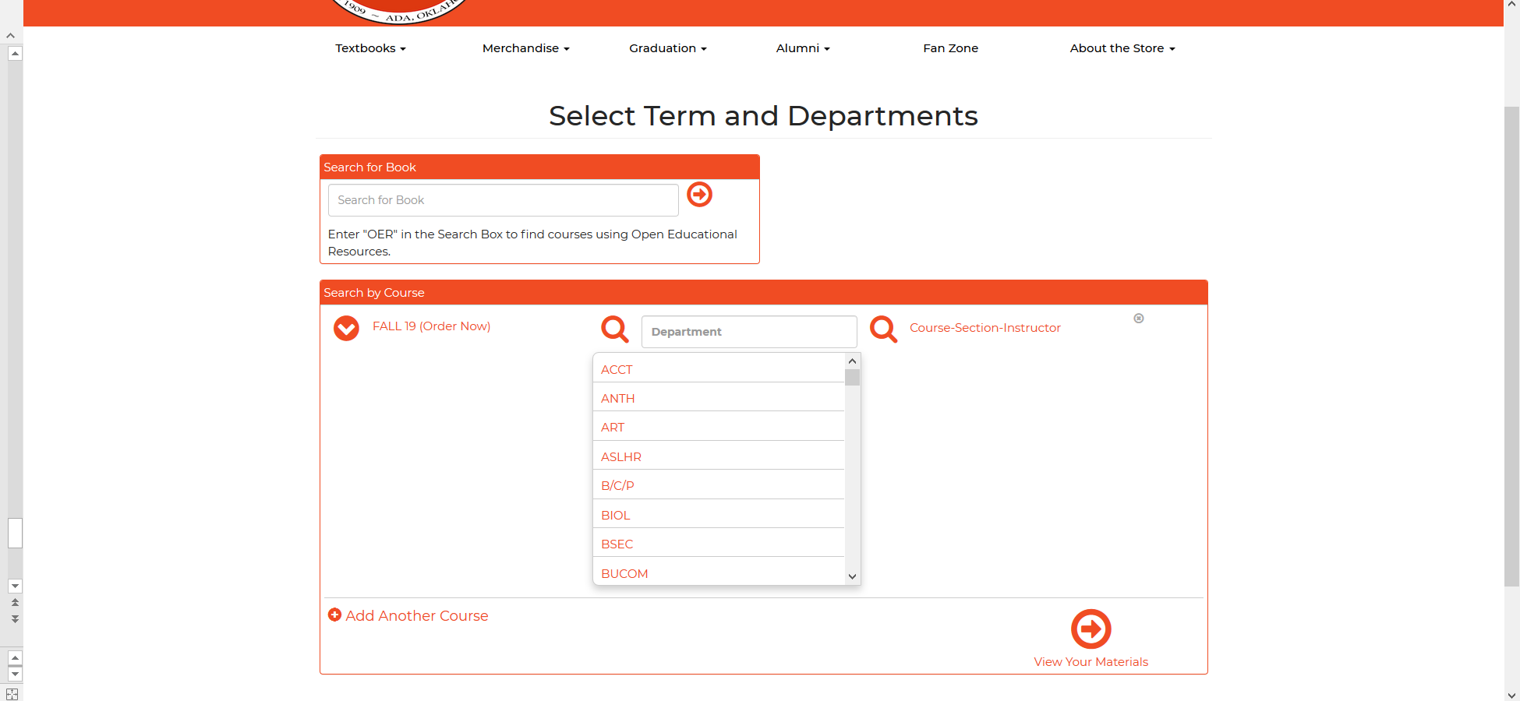

ECU Bookstore- Find My Books
Click Here
Scroll the drop down or type in the department prefix

Slide 23
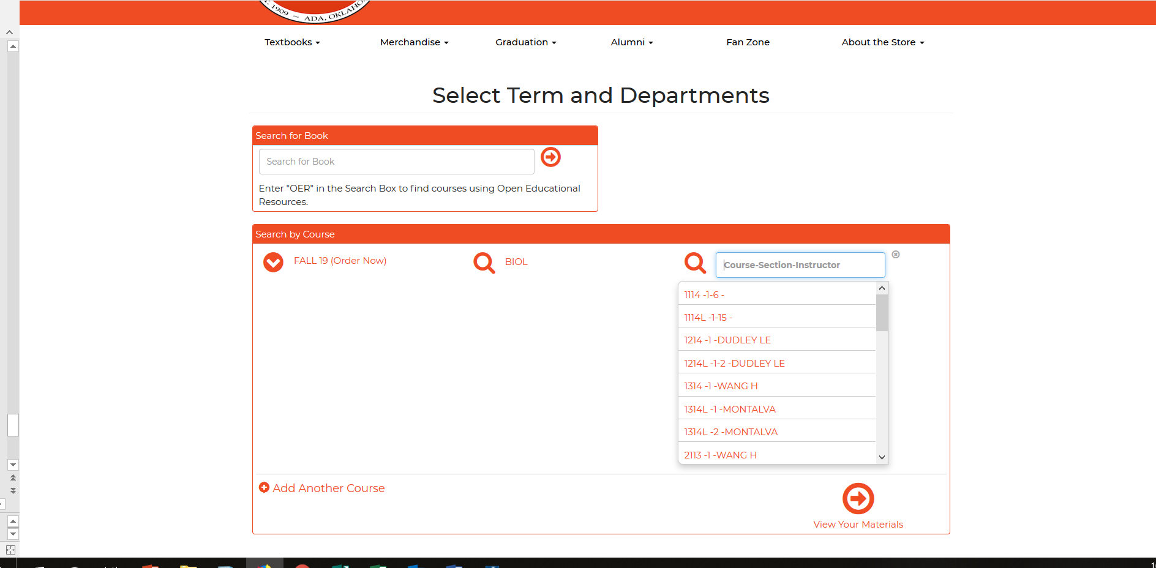
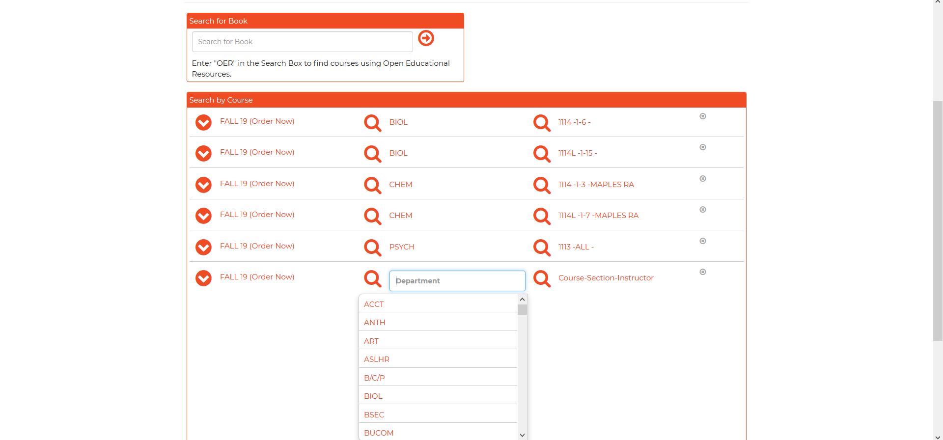
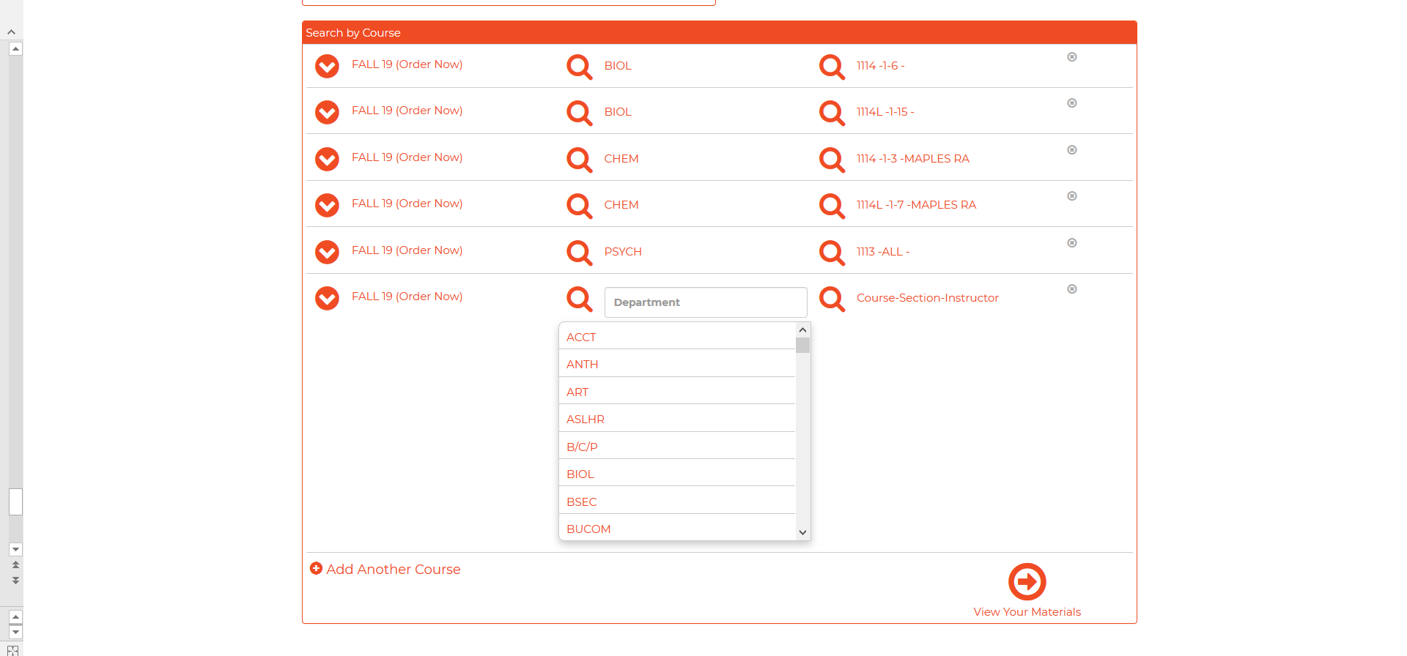
ECU Bookstore- Find My Books
Pick your course number and section
Select all your course books
Click the arrow to get your list

Slide 24
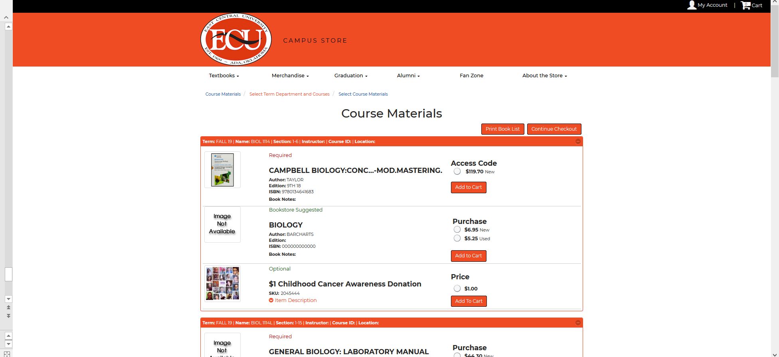
ECU Bookstore- Find My Books
Your list of books will be displayed with options for purchase or rental. You can order directly on line and have them sent to your home address, held for you at the bookstore or print your list to take into the bookstore when you are on campus.

Slide 25

Welcome to the ECU Family
We are glad you have chosen to continue your pursuit of a bachelor’s degree with
East Central University!
Remember: Once a Tiger, ALWAYS A TIGER!

